Slide 1

Eugene Police Flock

Slide 2
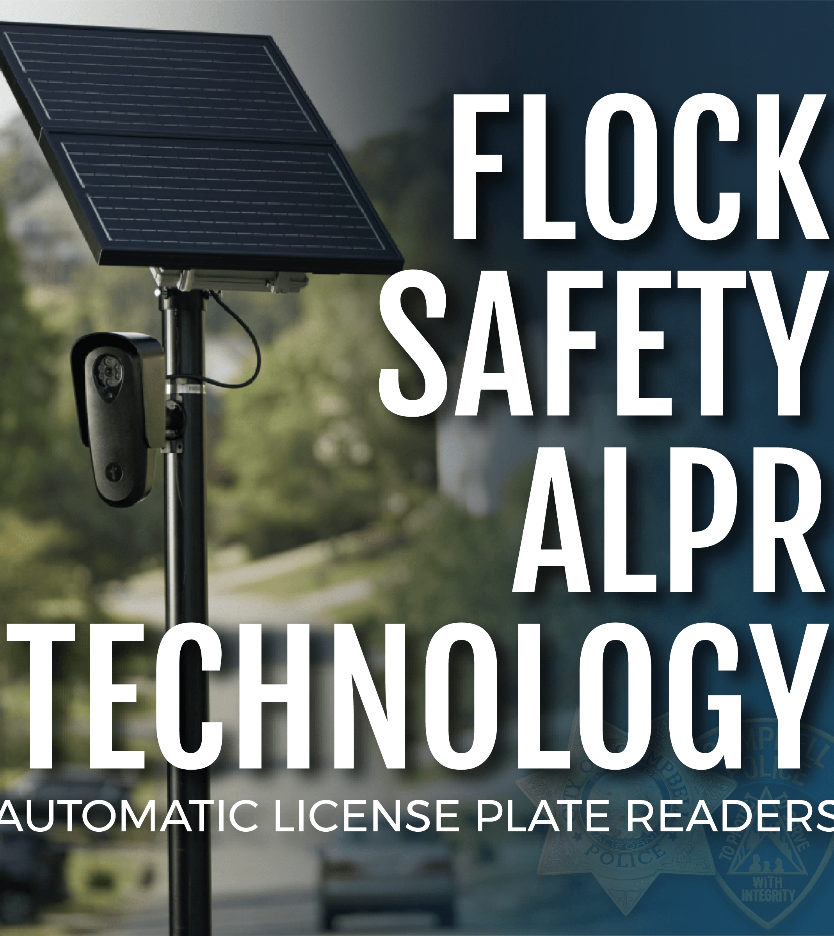
AGENDA
INTRODUCTION
How to Use flock- Desktop
How to use Flock- Mobile
Practical examples
Policy
FINAL TIPS & TAKEAWAYS

Slide 3
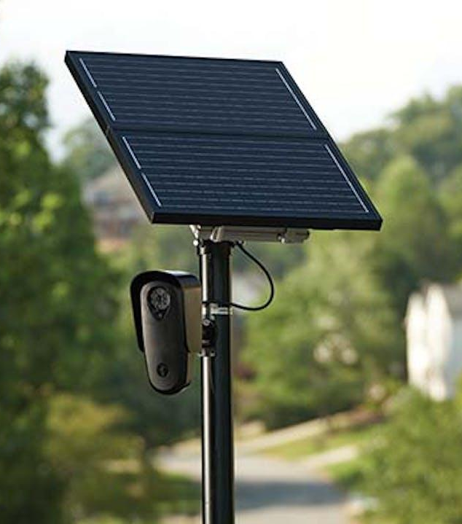
FLOCK camera's
Eugene will have 57 License Plate Reader (LPR) cameras mounted throughout Eugene. Springfield Police Department are installing another 25 cameras and Lane County Sheriffs Office is installing 15 in their respective jurisdictions. We worked with both departments so that the systems will compliment each other and provide better coverage.
Flock cameras are intended to capture the back of a vehicle. They then use this “Vehicle DNA” to match vehicles across the system even when there is no plate. Roadways that are a single lane, will often capture oncoming vehicles as well depending on traffic and conditions.
LPR cameras do not provide live access. They are motion activated. They capture several still images and combine them into one image to provide a license plate and vehicle description

Slide 4
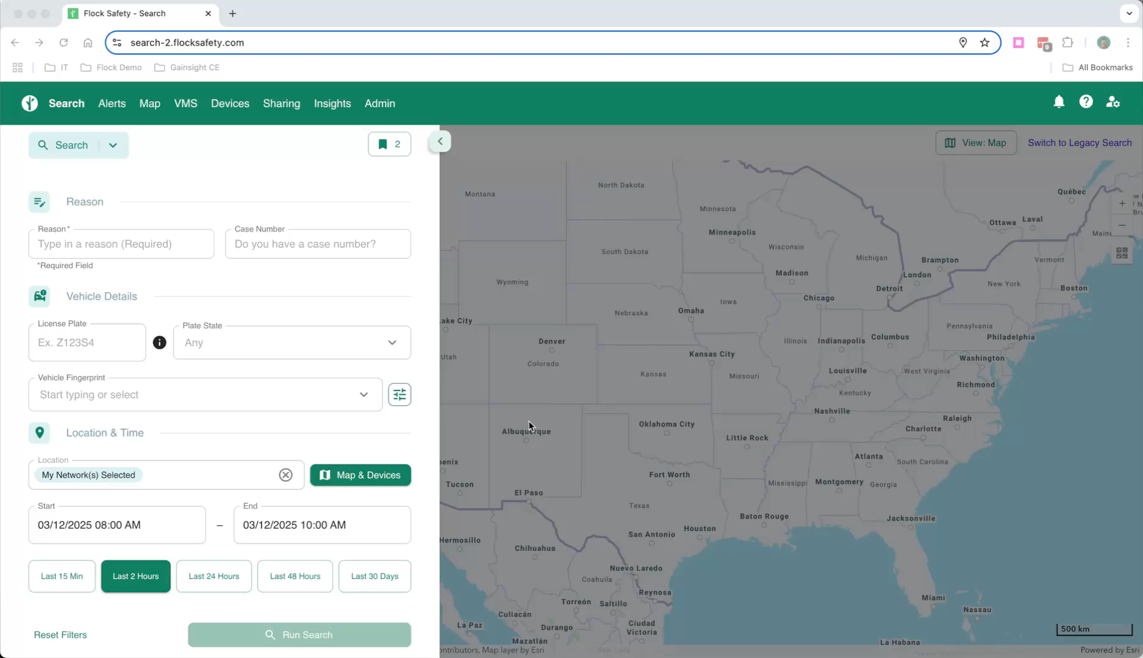
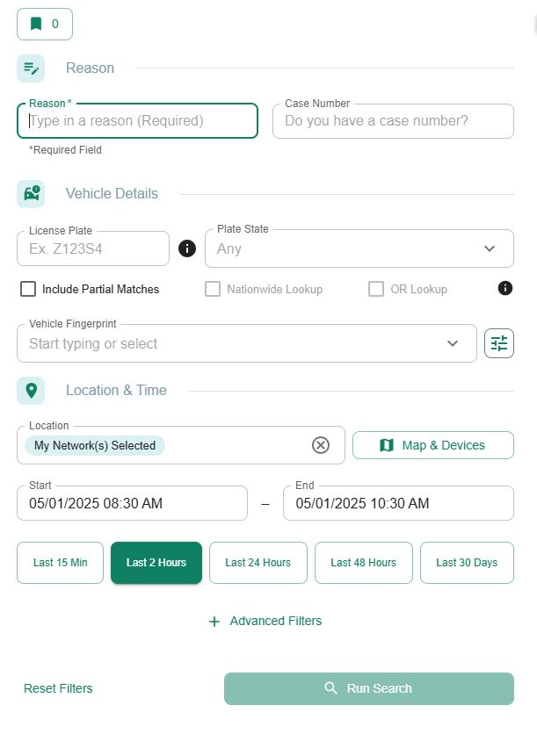
Flock Search VIdeo

Slide 5
How to use the Search Option
Key Points
Reason – For now, use one of the following. “Investigation” or “Missing Person”.
Case number- Provide whenever possible.
Plate – Best way to search.
Fingerprint – Use when plate isn’t available.
Location- By default, the cameras will only search our cameras. Live example of adding in additional cameras.
**Important Note**
Police agencies have a 30-day rolling retention period. Private entities have longer, so even if its outside the 30 days, run the search anyways as you may find usable information from private companies.
Nationwide lookup – Requires a full license plate.

Slide 6
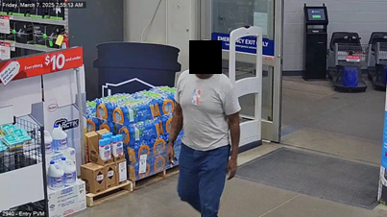
Case Study – Robbery 1
Case Details
On March 6th, 2025, XXXXXXXXXX was the victim of a Robbery 1. Investigators the following day were able to identify a partial plate for the vehicle. At that time we only had Lowe’s cameras, and that vehicle was captured the following morning in the parking lot of Lowes, which is across the street from XXXXXXXX.
-Vehicle was searched as a partial plate. When a matching vehicle was identified, a full plate search was run.

Slide 7
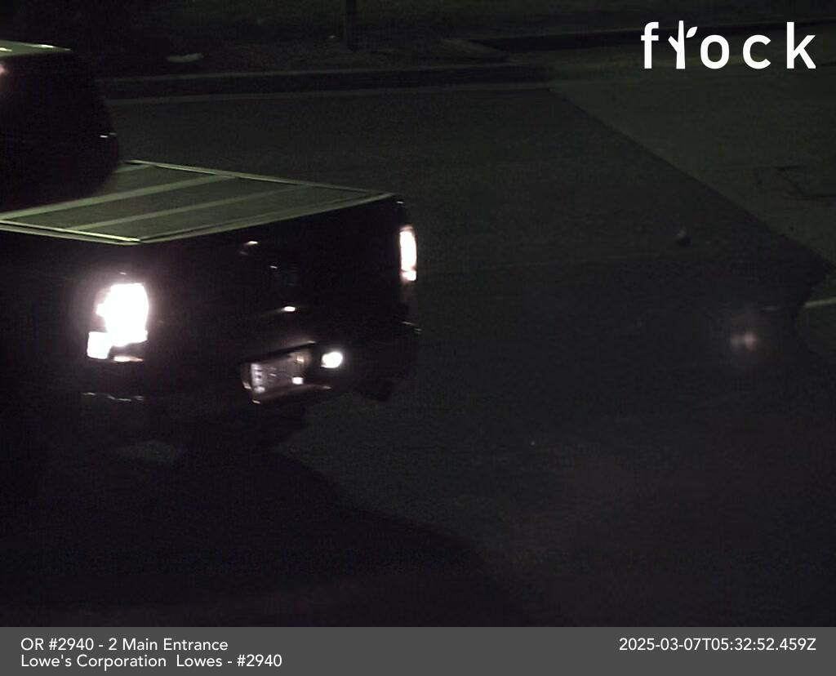
Case Study – Robbery 1
Case Details
-Video surveillance from a neighboring business captured the suspect vehicle pulling into Lowe’s immediately before the robbery, but a search returned no results with a matching time frame. Both with a plate entered and no plate entered.
-A second search was done and this time modifications to the search were added. The camera locations and time stayed the same, but we went into Advanced filers and changed the “Images” option from “images with plate” to “All Images.” With that change we located the following image. A matching vehicle and the first digit of the license plate matched the vehicle we were looking for.

Slide 8
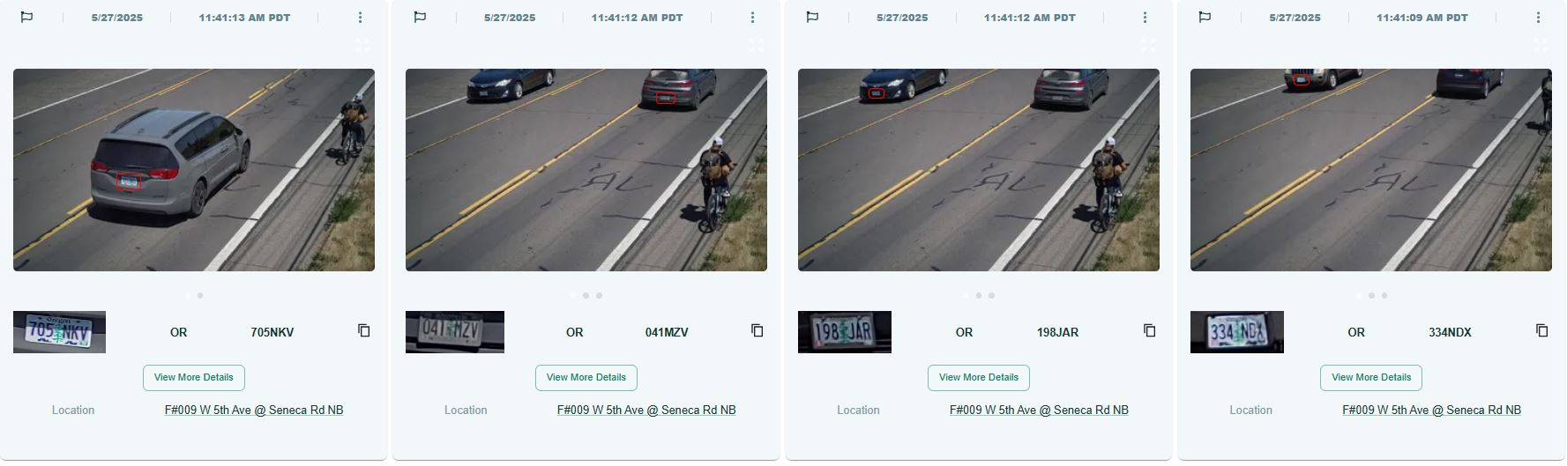
Practical Use example
Suspects without vehicle that pass ALPR
-Suspect on bicycle passed a known location of an LPR. A search was conducted and found that vehicles in the area, triggered the camera, thus capturing the bicycle. 341 results were returned within a window of a 15-minute search. Modify search in Advanced Filters to “all images” returned 542 results. In the first search, we had four pictures of this suspect. In the modified search, we located six images showing the suspect.

